Slide 1
PANDA’S
Data frame

Slide 2
High Performance
Advantages
Data Structure Tool
Analysis Tool
Open Source Python Library
Deals with Data-Frames

Slide 3
File Formats Allowed
Way in which the data is collected and stored.
Most commonly used is spreadsheet where rows are called as record and column holds data of same datatype
Other Commonly found are
Comma Separated Values (CSV)
Text Files

Slide 4
Comma Separated Values (.csv)
Spreadsheet format
Record separated values by comma’s
Opened with notepad (or) Microsoft excel

Slide 5
Excel Sheet
Spreadsheet format
Saved as .xlsx
Opened Microsoft excel

Slide 6
Importing Data
Importing CSV
Syntax:
name=pandas.read_csv(‘name’)
Importing spreadsheet
Syntax:
name=pandas.read_excel(‘name’,sheet_name)
Importing Text File
Syntax:
name=pandas.read_text(‘name’)

Slide 7
Making a Copy of Data frame
Shallow Copy:
Creates a new variable sharing the reference to the original object
Any changes made to the copy will reflect the original object
Syntax:
name = dataframe_name.copy(deep=‘false’)
Deep Copy
No reference is created to the original object
Changes will not be reflected in the original Object
Syntax:
name = datafram_name.copy(deep=‘true’)

Slide 8
Operations using Pandas Data frame
dataframe.index – Returns the low labels
dataframe.column – Returns the column label
dataframe.size – Returns the total no of elements
dataframe.shape – Returns the dimensionality
dataframe.memory_usage([index, deep]) – Returns the memory usage of various data types
dataframe.ndim – Returns the no of array dimensions
dataframe.head(n) – Returns first n rows
dataframe.tail(n) – Reutrns last n rows
dataframe.at[row_label, ‘column_label’] – Returns label value based on scalar look-up
dataframe.iat[row_label, ‘column_label’] – Returns label value based on integer look-up
dataframe.dtypes() – Returns data type of each column
dataframe.get_dtype_counts() – Returns the count of unique data types

Slide 9
Operations using Pandas Data frame
dataframe.select_dtypes() – Returns the columns from dataframe base din column data type
dataframe.astype() – Converts the datatype from one to another data type
dataframe[‘column’].nbytes() – Returns the total no of bytes consumed by elements of the column
dataframe.replace() – Used to replace a value with the desired value
dataframe.isnull.sum() – Returns the count of missing value present in each column
Getting Concise Summary
dataframe.info() – Returns the summary on data-type of index, columns, count of non-null values and the memory usage.

Slide 10
EXAMPLE USING CSV FILE ON PANDAS LIBRARY

Slide 11
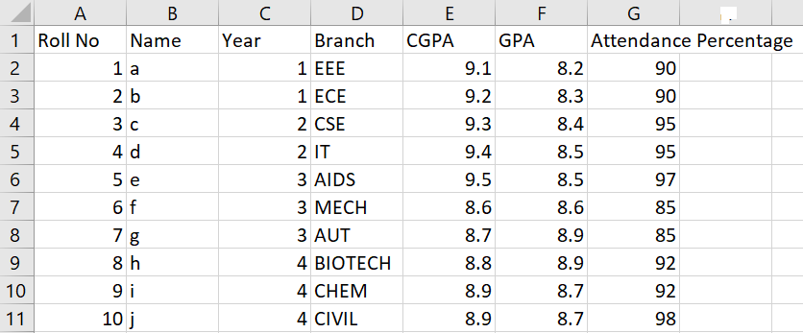
CSV FILE

Slide 12
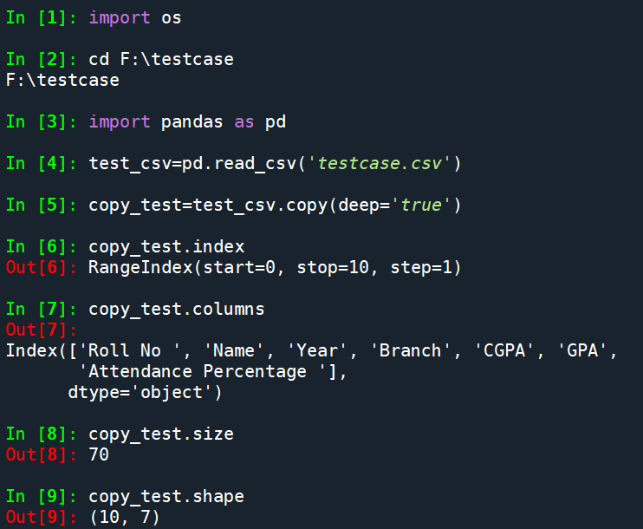

Slide 13
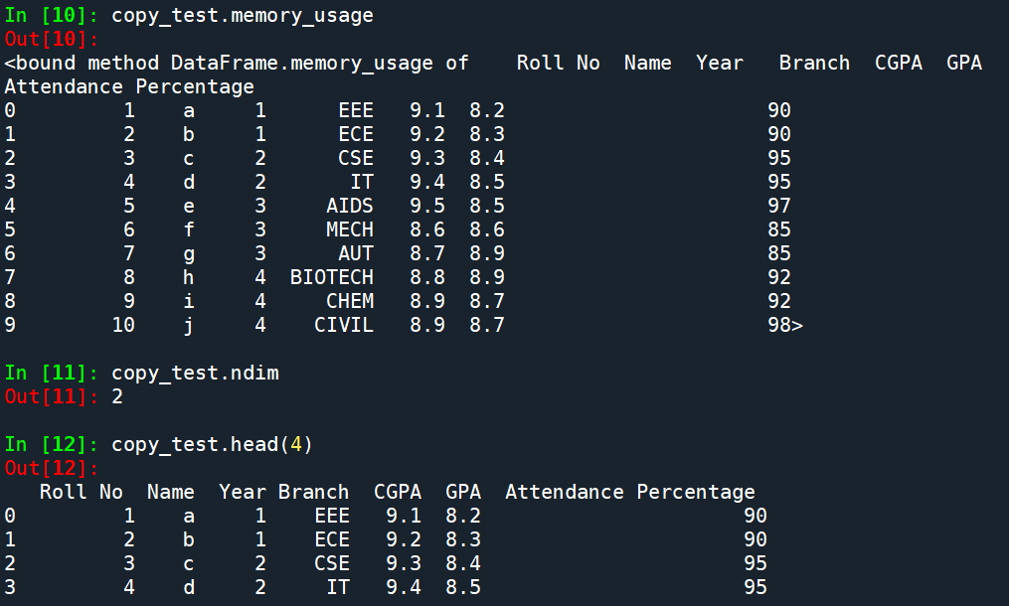

Slide 14
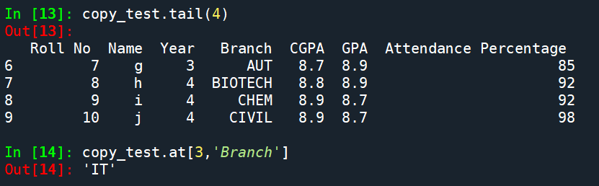


Slide 15
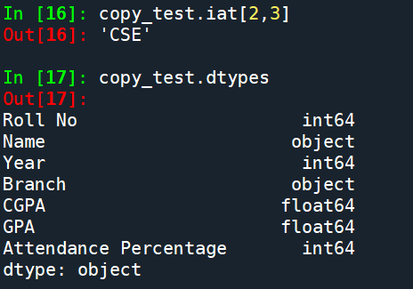

Slide 16
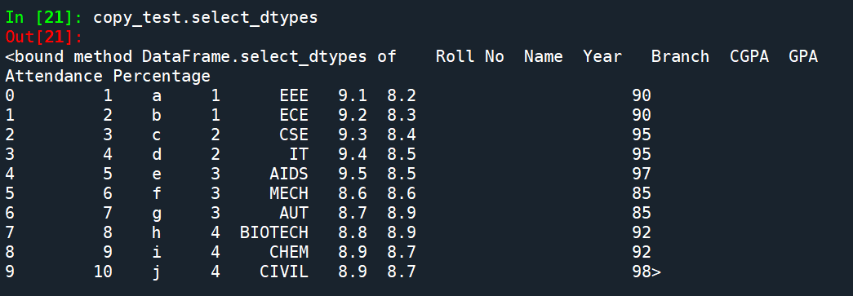
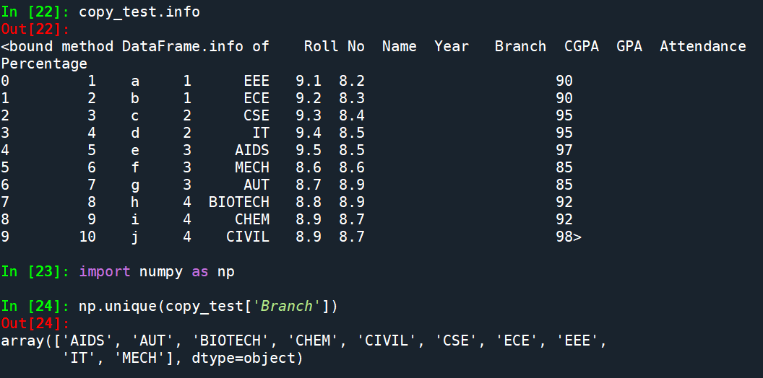

Slide 17
